Slide 1
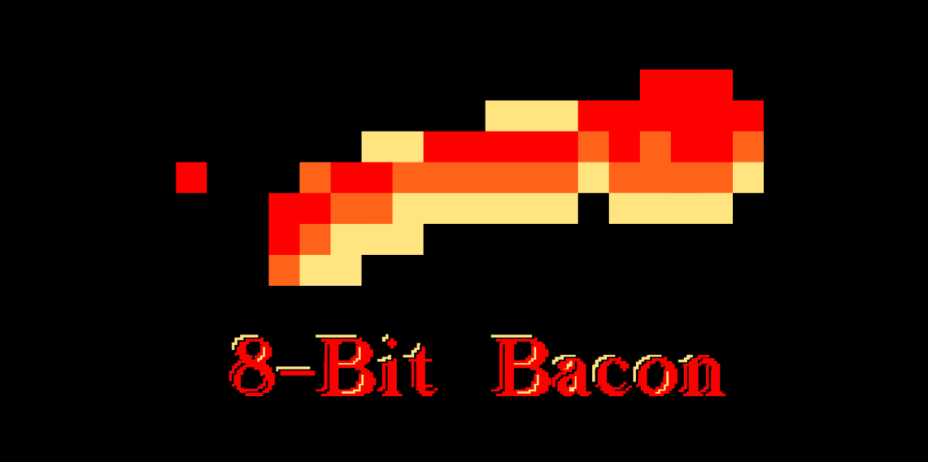
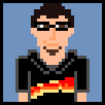



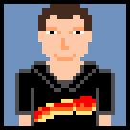

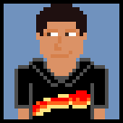


Our Team
Programmers
Artists
Anton Lopez
CJ Meade
Daniel Lima
Justin Maza
Matthew Birky
Roberto Rubiano
Sean Welch
Oscar Valera
Santiago Hoyos

Slide 2
Brainstorm 1 (WIP) Hack-n-Slash RPG

Slide 3
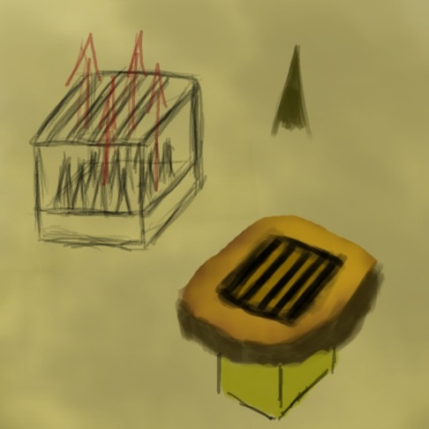
Game Mood and Pace
Intense
Constant waves of enemies
Environment keeps you moving
Fast-paced
Won’t die from getting hit a few times
Any environmental effects won’t kill the player instantly

Slide 4
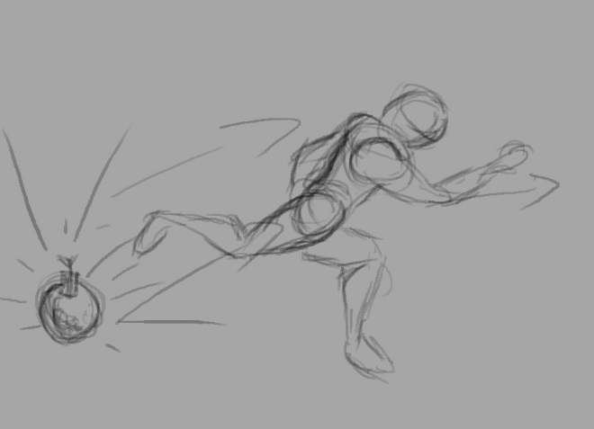
Player Actions
Dash – 25%
Dodge enemy attacks and environmental effects
Close distance to ranged enemies
Manipulate the environment(pushing boxes, buttons, etc)
Attack – 75%
Damage Enemies
Destroy Environment
Deflect Ranged attacks

Slide 5
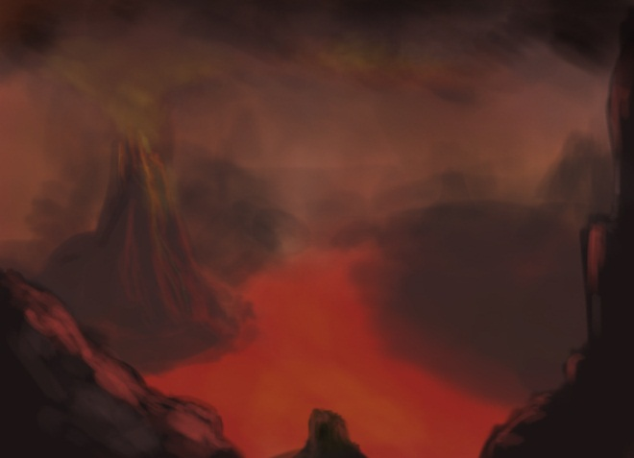
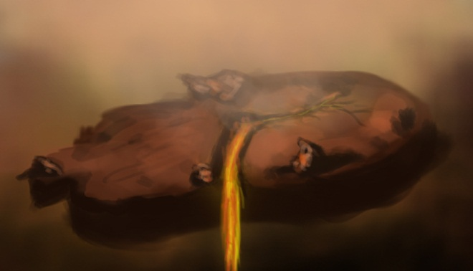
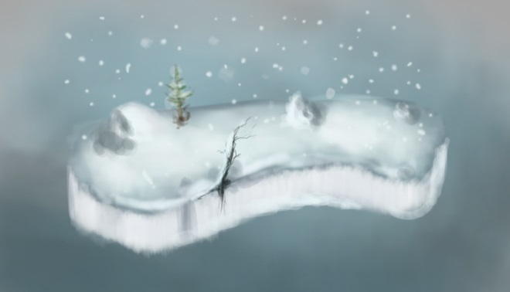
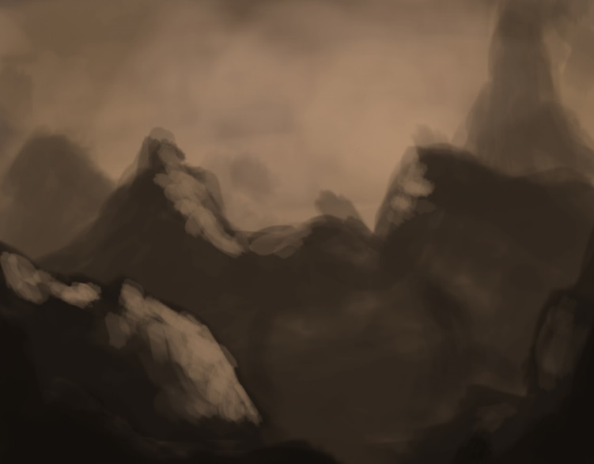
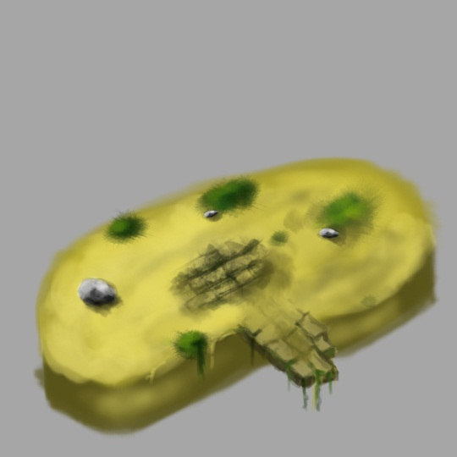
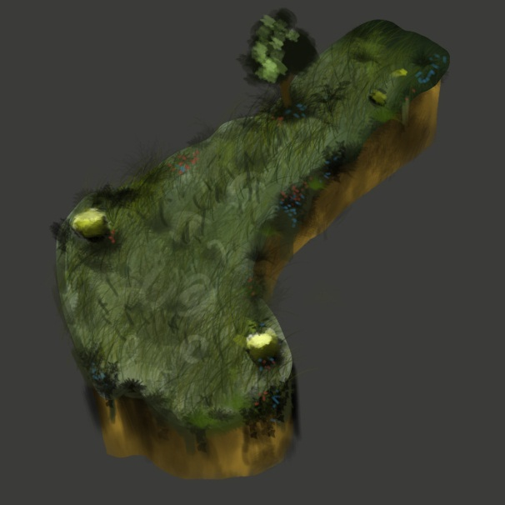
Where
Alternate fantasy realm

Slide 6
Game Structure
Progress
Combat
Progress
Combat
Exit

Slide 7
Level Flow
Level Start
Close Distance
Damage Enemies
Open Door
Dodge Spikes
Dodge
Close Distance
Damage Enemies
Deflect Ranged Attack
Close Distance
Damage Enemies
Dodge Spikes
Open Door
Level End
Key
Attack
Dash

Slide 8
Questions?

Slide 9
Brainstorm 2 (WIP) First-Person Shooter

Slide 10
Game Mood and Pace
Intense
Possibility of enemies appearing spontaneously
Moderate
Taking a few hits from enemies will kill the player
Environment can shield you

Slide 11
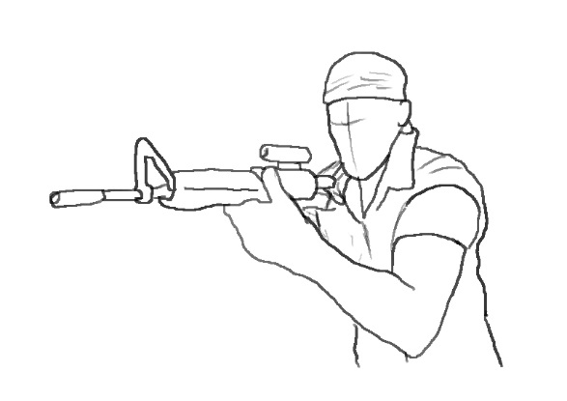
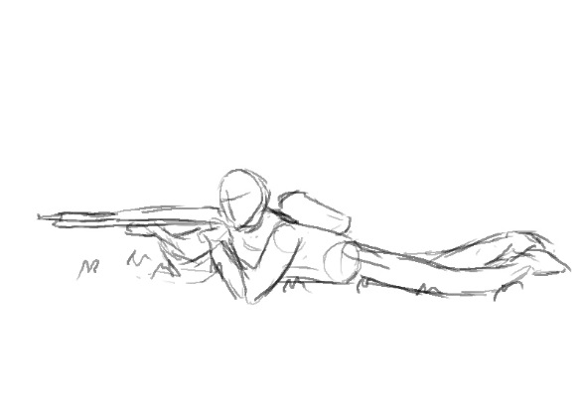
Player Actions
Shoot – 50%
Kill Enemies
Manipulate Environment
Sprint – 30%
Run Away
Get To Cover
Collect Items
Crouch – 20%
Hide Behind Cover
Increase Accuracy
Smaller Target

Slide 12
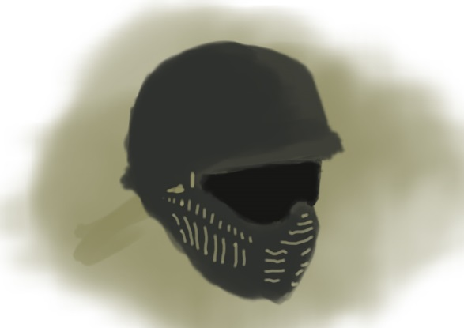
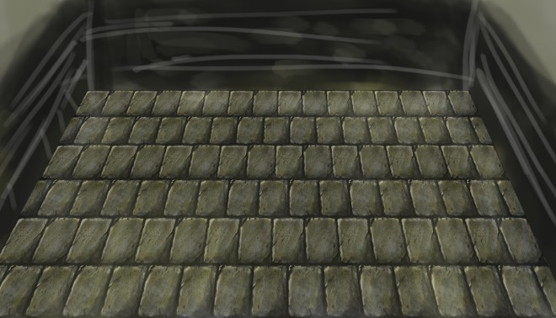
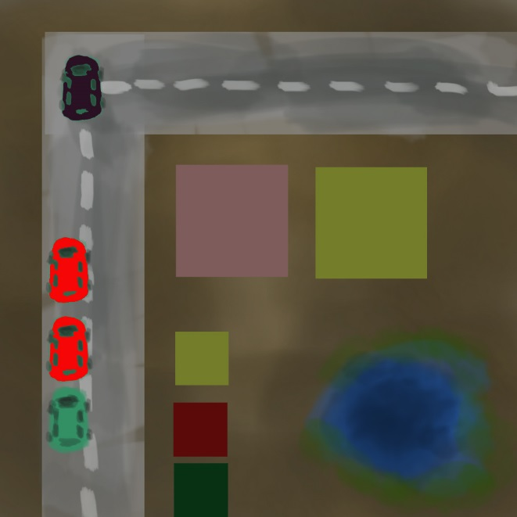
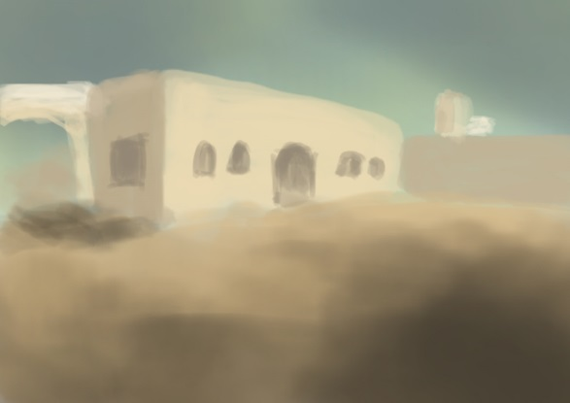
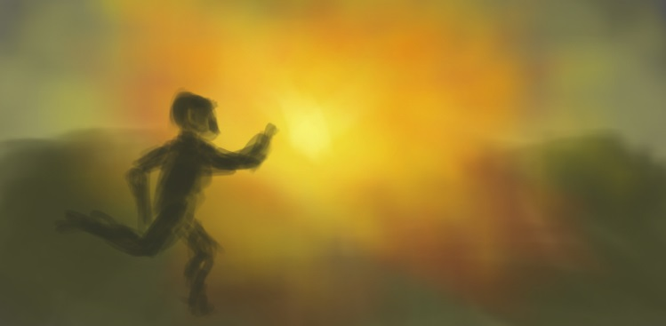
Where
Modern day urban environment

Slide 13
Game Structure
Progress
Combat
Progress
Combat
Exit
Complete Wave
Complete Wave
Boss Wave

Slide 14
Level Flow
Level Start
Sprint to cover
Take cover
Kill enemies
Collect items
Clear obstacles
Smaller target
Kill enemies
Manipulate environment (close gate)
Kill enemies
Get to finish
Level end
Key
Sprint
Shoot
Crouch

Slide 15
Questions?

